Slide 1

STREAMING AND DIGITAL MUSIC CONSUMPTION
SENTIMENT ANALYSIS OF GOLDEN ALBUM BY JK
Manel Mehemli
Salma Louhaichy
ID:1027313
ID:1065014
November 28th, 2023

Slide 2

TABLE OF CONTENTS
01
05
Introduction
Data Pre-Processing
02
06
Background
Sentiment Analysis
03
07
Architecture
Data Visualisation
04
08
Data Scraping
Conclusion

Slide 3

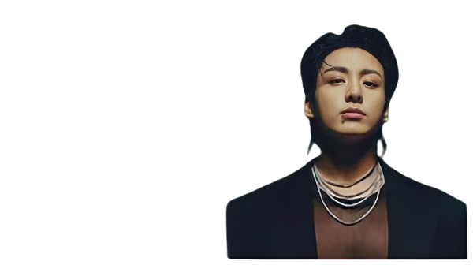
INTRODUCTION
Streaming and digital music consumption.
Sentiment analysis and real time data streaming.
Golden the Album by Jungkook
Keywords :
Data Scraping
Sentiment Analysis
Data Visualization
Data Processing

Slide 4
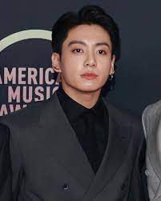


BACKGROUND:
Jeon Jungkook
Member of BTS
Musician, Singer, Songwriter
First solo album
Released on 03/11/2023

Slide 5

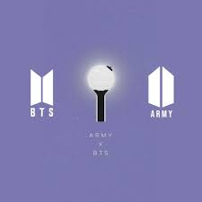
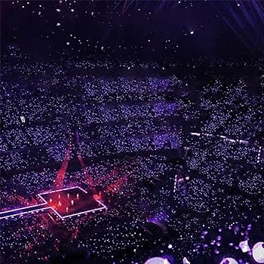
FANBASE SIZE
A National Treasure
The Hyundai Research institute found that about 800,000 visitors visit South Korea because of BTS every year.
The Band itself brings over $3.9 billion to the South Korean economy.
OUR TWEETS COME FROM EVERYWHERE
Massive social media engagement
Over the last 10 years, there have been close to 2 billion mentions of BTS . And 36.96M unique authors initiated conversations about BTS on Twitter.
With a fanbase amassing millions from around the world, BTS are known to be the music group with the most twitter engagements ever recorded - which they have topped four times.

Slide 6

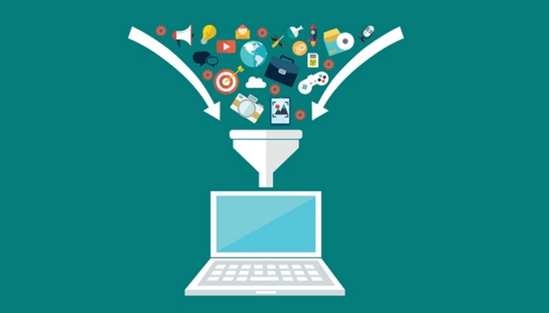
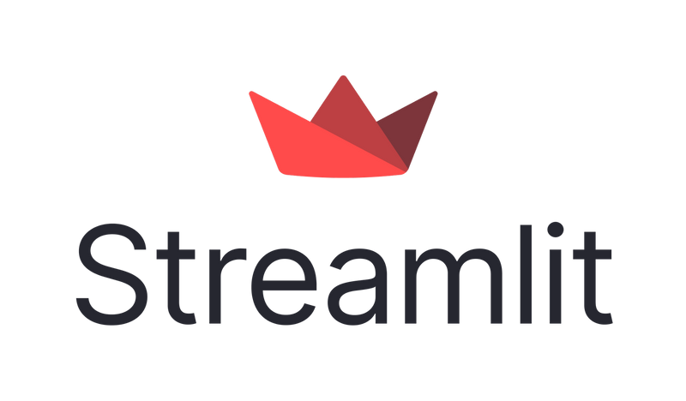

ARCHITECTURE:
Twitter Data Scraping
Data pre-processing
Visualization
Sentiment analysis

Slide 7
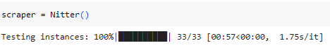

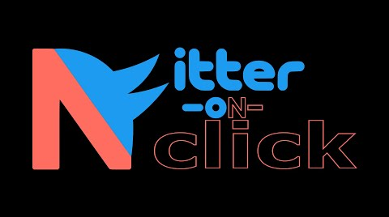
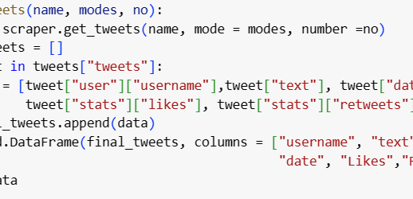
DATA SCRAPING
NTSCRAPER LIBRARY
NITTER INSTANCES
get_tweets()
This is a simple python library which allows scraping tweets from Nitter instances.
Nitter instances act as intermediaries between users and Twitter. They provide a privacy-focused and less resource-intensive way to access Twitter content.
Gets tweets from scraper
Extracts user, likes, retweets, date and text.
Stores Data in Pandas Dataframe.

Slide 8
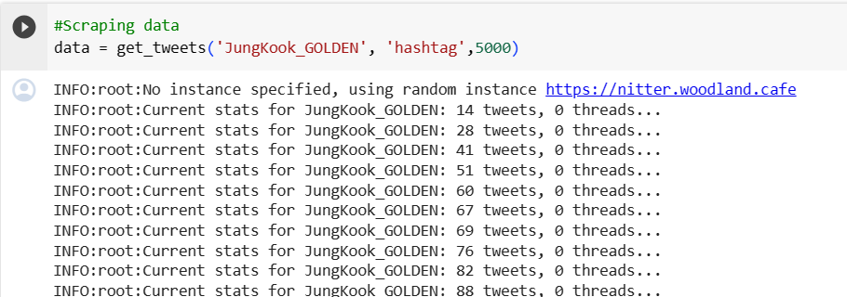
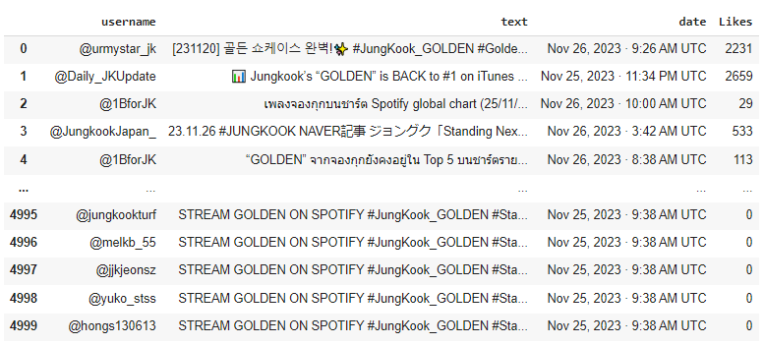

DATA SCRAPING

Slide 9
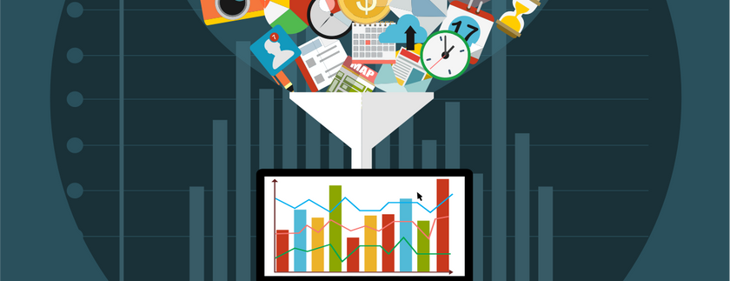
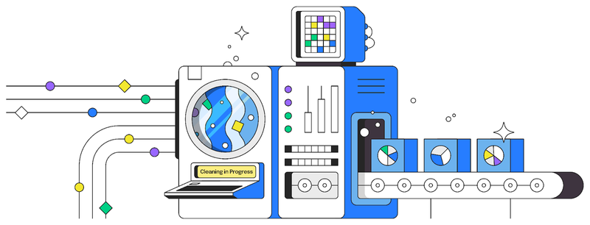
DATA PRE-PROCESSING
01
Translation to English
It is important to set one global language to be used for our analysis later : English.
Library “langdetect” to detect languge
Library “googletrans” for the translation
02
Cleaning the Tweet Texts
Remove all mention, hashtags, links, numbers, words with numbers,....
Transform emojis to their textual format using library “emoji”.
03
Setting the correct Datatypes
Date Format extracted from scraper seperated by “.”, cannot be used by data visualization functions.

Slide 10
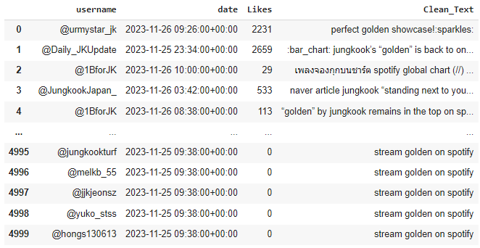


Slide 11

DATA ANALYSIS
01
TextBlob Library
TextBlob is a popular Python library used for processing textual data. It simplifies many natural language processing (NLP) tasks, offering a high-level interface to perform common operations like sentiment analysis...
02
Tweet Polarity
03
Sentiment Analysis
The polarity score is usually within the range [-1.0, 1.0], where:
-1.0 indicates highly negative sentiment.
0.0 indicates neutral sentiment.
1.0 indicates highly positive sentiment.
Depending on the polarity score, we defined :
Polarity=0 => Neutral
Polarity<0 => Negative
Polarity>0 => Positive

Slide 12
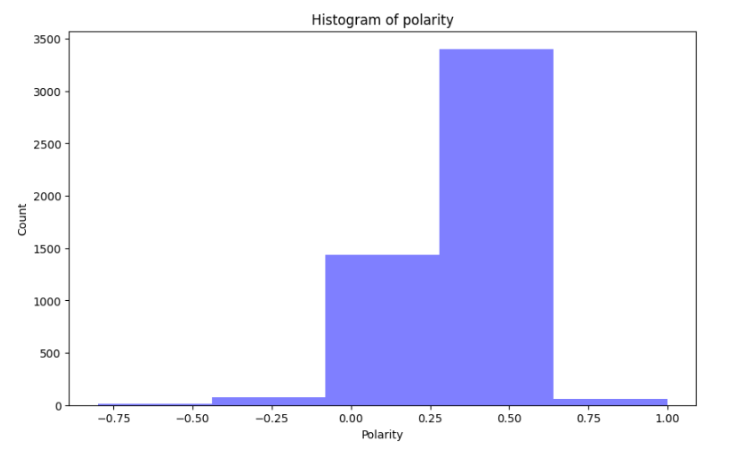
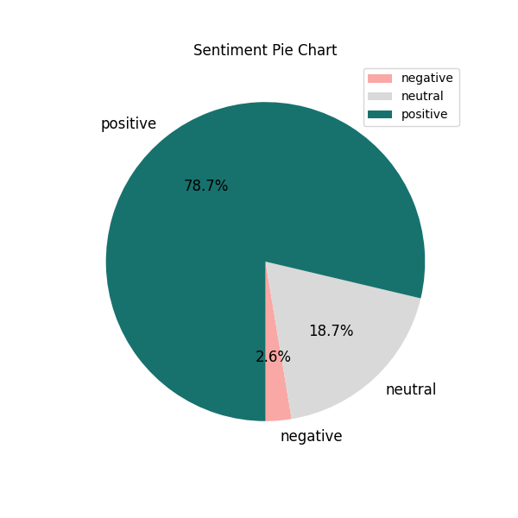
ANALYSIS RESULTS
Overall High Polarity
Positive Sentiment

Slide 13
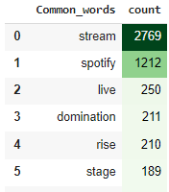
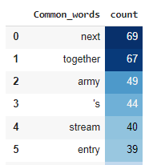
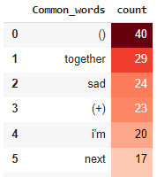
Most used words:
Positive:
Neutral:
Negative:

Slide 14
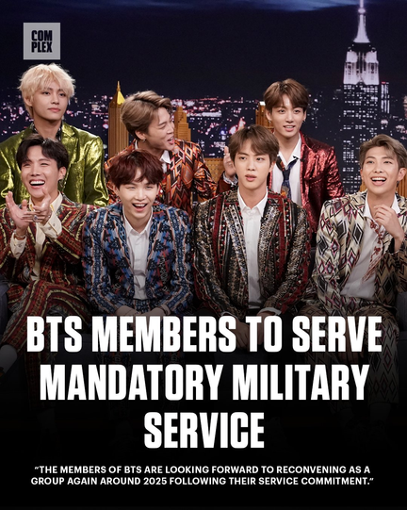
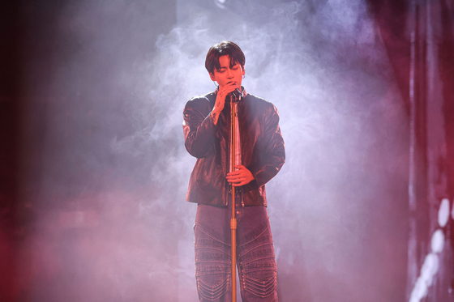

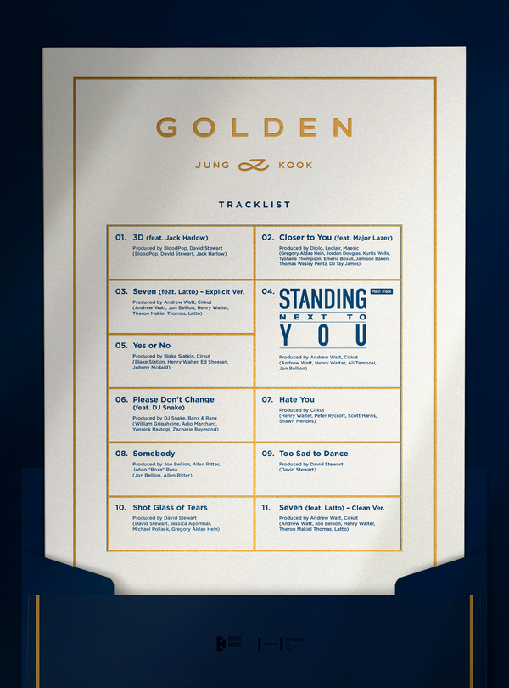
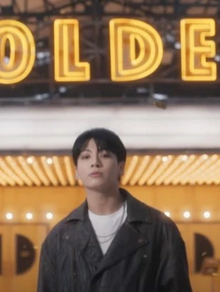
03/10 - 05-10 Official announcement of the album and concept photoshoot post. | 15/10-20/10 Tracklist announed + Main track poster + Album tracks | 30/10 Album preview | 01/11-03/11 Main track official MV TEASER + Main track official MV | 20/11 First Live Showcase +12M viewers | 22/11 Military enlistment announcement
EVENT TIMELINE
6
03-10-2023 to 26-11-23
5
4
3
2
1

Slide 15
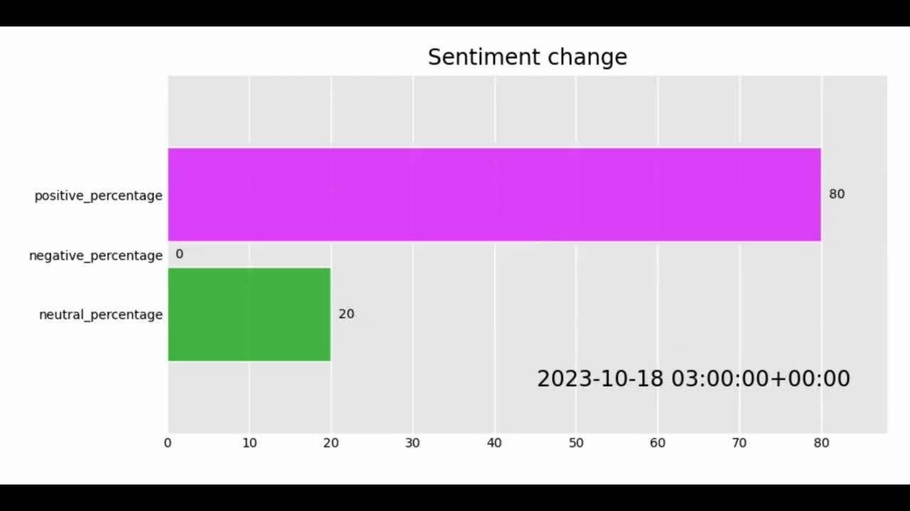
Visualisation of change in sentiments from 03/10 to 26/11:

Slide 16
INTERACTIVE SENTIMENT VISUALIATION

Slide 17
DASHBOARD DEMO

Slide 18

CHALLENGES
Twitter API 1500 tweet/day scraping limit.
Pay-per-use Scrapers and visualisation toold.
Limited processing power.
Unrelated tweets using the search hashtag “ #Jungkook_Golden”.
Real - time visualization still a work in progress.

Slide 19

CONCLUSION
Sentiments are overall positive to the Album.
Change of trend : from admiring the music to streaming it on spotify.
Events related to the artist affect greatly the sentiment analysis.
OVERALL SENTIMENT
79%

Slide 20
REFERENCES:
Aimated bar chart race: https://github.com/amrrs/youtube-r-snippets/blob/master/Python_Matplotlib_Animated_Bar_Chart_Race.ipynb
ntscraper: https://app.soos.io/research/packages/Python/-/ntscraper
Mr_KnowNothing. 2019,Twitter sentiment Extaction-Analysis,EDA and Model https://www.kaggle.com/code/tanulsingh077/twitter-sentiment-extaction-analysis-eda-and-model#Most-Common-words-in-Text
Activity 3 “Sentiment Analysis (FIFA dataset)” week 6 Big data
https://pypi.org/project/ntscraper/
https://www.brandwatch.com/blog/bts-facts-and-statistics/
https://textblob.readthedocs.io/en/dev/
https://www.latentview.com/data-engineering-lp/introduction-to-streamlit/#:~:text=Streamlit%20is%20an%20open%20source,NumPy%2C%20pandas%2C%20Matplotlib%20etc.

Slide 21
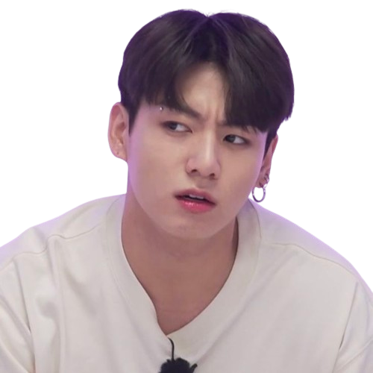
Any questions?

